Slide 1
Unit 7: Searching and Hashing
Introduction to Searching, Search Algorithms: Sequential Search, Binary Search, Efficiency of Search Algorithms, Hashing : Hash Function and Hash Tables, Collision Resolution Techniques

Slide 2
Searching
Process of checking and finding an element from a list of elements.
Let A be a collection of data elements, i.e., A is a linear array of say n elements. If we want to find the presence of an element "data" in A, then we have to search for it.
The search is successful if data does appear in A and unsuccessful if otherwise.
There are several types of searching techniques :
Linear or Sequential Searching(Small arrays and unsorted arrays) ,
Binary Searching(Large arrays and sorted arrays)

Slide 3
Sequential / Linear Search
Linear Search is a method for finding a target value within a list.
It sequentially checks each element of the list for the target value until a match is found or until all the elements have been searched.
Linear search algorithm finds a given element in a list of elements with 0(n) time complexity where n is total number of elements in the list.
Algorithm:
Start from the leftmost element of array and compare each element one by one with x.
If x matches with an element, return the index (hit).
If x doesn't match with any of elements, return -1(miss).

Slide 4
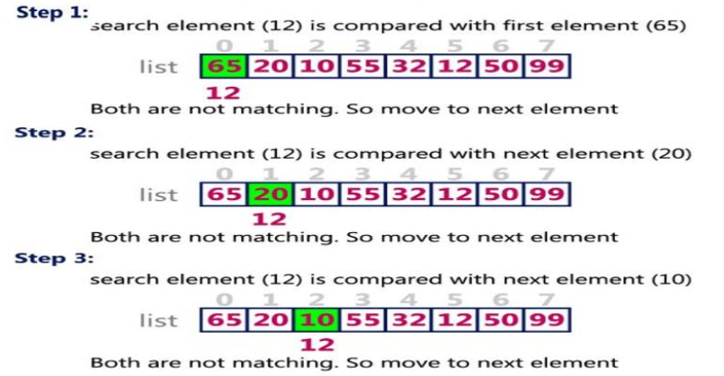
Sequential / Linear Search[2]
Search 12 in list of element {65,20,10,55,32,12,50,99}

Slide 5
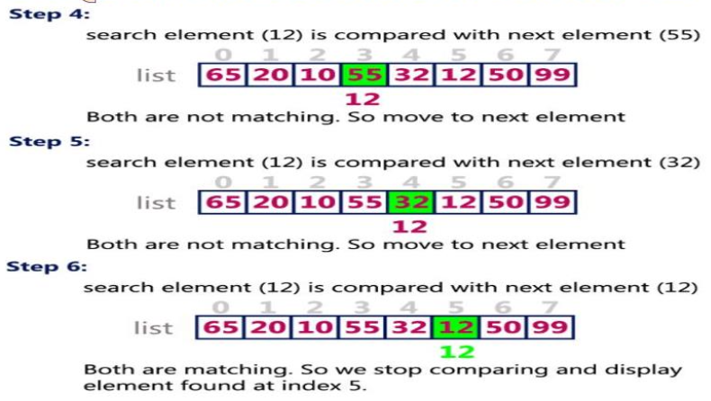
Sequential / Linear Search[3]

Slide 6
Sequential / Linear Search - Analysis
Worst case scenario => The target element is not in the list of at the end
Total Comparisons = n, so complexity is O(n)
Best Case Scenario => The target element is at the first position
Total Comparisons = 1, so complexity is O(1)
Average Case Scenario The target element can be anywhere in the list
Total comparisons = average of possible comparisons. Ie: [ n+(n-1)+(n-2)+.....+1) / n comparison, so the complexity is O(n)

Slide 7
Sequential / Linear Search - Assignments
For a given array: {65,20,10,55,32,12,50,99}
Find the element 65
Find the element 55
Find the element 100

Slide 8
Binary Search
Binary search can be implemented only on a sorted list of items.
If the elements are not sorted already, we need to sort them first.
Binary search follows divide and conquer approach in which, the list is divided into two halves and the item is compared with the middle element of the list.
If the match is found then, the location of middle element is returned otherwise, we search into either of the halves depending upon the result produced through the match.
Binary search algorithm reduce the time complexity of search on sorted array to O(Log n)

Slide 9
Binary Search - Algorithm
Step 1: Find the index of the middle (central) element as: Mid = (first + last) / 2
Step 2: If the element is at the mid, return mid
Step 3: If the element at the mid is greater than the element to be searched ie element[mid] > number, then update last index as: last = (mid-1) and go to Step 1.
Step 4: If the element at the mid is less than the element to be searched ie element[mid] < number, then update last index as: first = (mid+1) and go to Step 1.
Step 5: Continue until mid == 0
Step 6: Display number not found, if mid becomes 0.

Slide 10
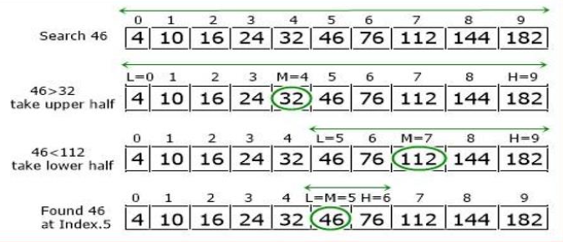
Binary Search - Example
Search an element 46 from the list 4,10,16,24,32,46,76,112,144,182 using binary search algorithm.

Slide 11
Binary Search - Assignment
For the list of items: {4,10,16,24,32,46,76,112,144,182}
Find 4
Find 182
Find 32

Slide 12
Hashing
Hashing is a technique that is used to uniquely identify a specific object from a group of similar objects. Some examples of how hashing is used in our lives include:
In universities, each student is assigned a unique roll number that can be used to retrieve information about them.
In libraries, each book is assigned a unique number that can be used to determine information about the book, such as its exact position in the library or the users it has been issued to etc.
In both these examples the students and books were hashed to a unique number.
Assume that you have an object and you want to assign a key to it to make searching easy.
To store the key/value pair, you can use a simple array like a data structure where keys (integers) can be used directly as an index to store values.
However, in cases where the keys are large and cannot be used directly as an index, you should use hashing.

Slide 13
Hashing[2]
In hashing, large keys are converted into small keys by using hash functions.
The values are then stored in a data structure called hash table.
The idea of hashing is to distribute entries (key/value pairs) uniformly across an array.
Each element is assigned a key (converted key).
By using that key you can access the element in 0(1) time.
Using the key, the algorithm (hash function) computes an index that suggests where an entry can be found or inserted.

Slide 14
Hashing[3]
Hashing is implemented in two steps:
An element is converted into an integer by using a hash function.
This element can be used as an index to store the original element, which falls into the hash table.
The element is stored in the hash table where it can be quickly retrieved using hashed key. hash = hashfunc(key) index = hash % array_size

Slide 15
Hash Function
A hash function is any function that can be used to map a data set of an arbitrary size to a data set of a fixed size, which falls into the hash table.
A common hash function is h(x)=x mod SIZE
if key=27 and SIZE=10 then hash address = 27 mod 10 = 7
The values returned by a hash function are called hash values, hash codes, hash sums, or simply hashes.
To achieve a good hashing mechanism, It is important to have a good hash function with the following basic requirements:
Easy to compute: It should be easy to compute and must not become an algorithm in itself
Uniform distribution: It should provide a uniform distribution across the hash table and should not result in clustering.
Less collisions: Collisions occur when pairs of elements are mapped to the same hash value. These should be avoided.

Slide 16
Hash Function - Types
Division method
In this the hash, function is dependent upon the remainder of a division. For example:-if the record 52,68,99,84 is to be placed in a hash table and let us take the table size is 10. Then: h(key)=record% table_size. 2=52%10; 8=68%10; 9=99%10 4=84%10
Mid square method
In this method firstly key is squared and then mid part of the result is taken as the index. For example: consider that if we want to place a record of 3101 and the size of table is 1000. So 3101*3101 - 9616201 i.e. h (3101) = 162 (middle 3 digit)
Digit folding method
In this method the key is divided into separate parts and by using some simple operations these parts are combined to produce a hash key. For example: consider a record of 12465512 then it will be divided into parts i.e. 124, 655, 12. After dividing the parts combine these parts by adding it. H(key)=124+655+12 =791

Slide 17
Hash Function - Characteristics
The hash function is easy to understand and simple to compute.
The hash function should produce the keys which will get distributed, uniformly over an array.
The hash function should generate different hash values for the similar string.
A number of collisions should be less while placing the data in the hash table.
The hash function is a perfect hash function when it uses all the input data.

Slide 18

Hash Table
A hash table is a data structure that is used to store keys/value pairs.
It uses a hash function to compute an index into an array in which an element will be inserted or searched.
By using a good hash function, hashing can work well.
Under reasonable assumptions, the average time required to search for an element in a hash table is 0(1).
Load Factor of the Hash Table: It is the denoted by the symbol
= (number of items in the table) / tablesize Example: Assume that the tablesize is 10 and it consists of 6 items, then the load factor of the table is = 6/10 = 0.6

Slide 19
Hash Table - Example
Suppose we have a set of strings ("abc", "der, "ghi"} that we'd like to store in a table.
Our objective here is to find or update them quickly from a table, actually in 0(1).
We are not concerned about ordering them or maintaining any order at all. Let us think of a simple schema to do this.
Suppose we assign "a" = 1, "b"=2, ... etc to all alphabetical characters.
We can then simply compute a number for each of the strings by using the sum of the characters as follows. "abc" = 1 + 2 + 3=6, "def' = 4 + 5 + 6=15 , "ghi" = 7 + 8 + 9=24
If we assume that we have a table of size 5 to store these strings, we can compute the location of the string by taking the sum mod 5.
So we will then store "abc" in 6 mod 5 = 1, def in 15 mod 5 = 0, and "ghi" in 24 mod 5 = 4 in locations 1, 0 and 4 as follows.

Slide 20
Collision Resolution Techniques
If x1 and x2 are two different keys, it is possible that h(x1) = h(x2).
This is called a collision.
A collision occurs when two different keys hash to the same value
E.g. For Table Size = 17, the keys 18 and 35 hash to the same value 18 mod 17 = 1 and 35 mod 17 = 1
Collision Resolution Techniques are the techniques used for resolving or handling the collision.
The process of finding an alternate location is called collision resolution.
Even though hash tables have collision problems, they are more efficient in many cases compared to all other data structures, like search trees.
There are a number of collision resolution techniques, and the most popular are direct chaining and open addressing.

Slide 21
Collision Resolution Techniques(2)
Direct Chaining => Linked list based implementation
Separate Chaining
Open Addressing => Array -based implementation
Linear Probing => linear search
Quadratic probing => nonlinear search
Double hashing => use of two hash functions

Slide 22
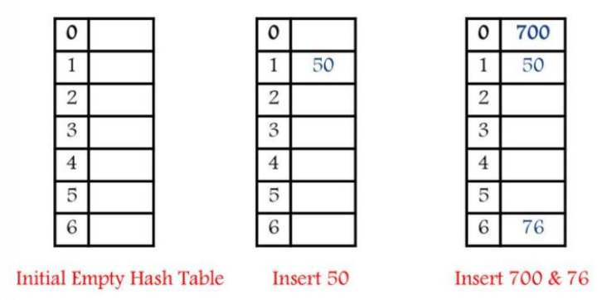
Collision Resolution Techniques => Separate Chaining
In this technique, a linked list is created from the slot in which collision has occurred, after which the new key is inserted into the linked list.
This linked list of slots looks like a chain, so it is called separate chaining.
It is used more when we do not know how many keys to insert or delete.
Hashing for keys: [key mod 7]
50, 700, 76, 85, 92

Slide 23
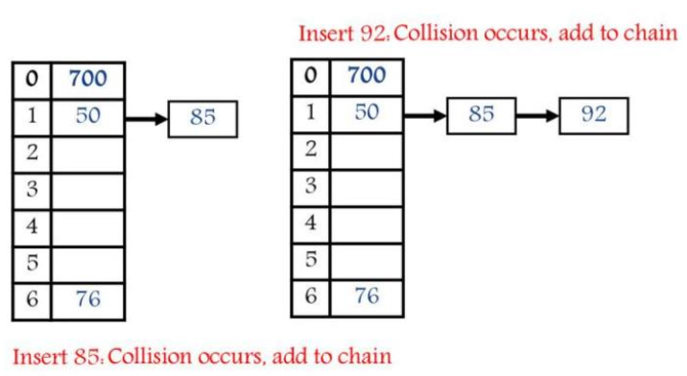
Collision Resolution Techniques => Separate Chaining[2]
Hashing for keys: [key mod 7]
50, 700, 76, 85, 92, 73?, 101?

Slide 24
Collision Resolution Techniques => Separate Chaining[3]
Advantages
Simple to implement
Hash table never fills up, we can always add more elements to chain as it is dynamic.
Disadvantages
Uses extra space for links.
Wastage of space - some parts of hash table might never be used
If the chain becomes too long, then search time can become O(n) in worst case

Slide 25
Collision Resolution Techniques => Separate Chaining[4]
Analysis
Worst Case
All keys into the same bucket
A single linked list is used
Insert, delete and search will take O(n) time.
Average Case
Keys are uniformly distributed into buckets.
O(1+N/B): where N is the number of elements in the hash table B is the number of buckets
If N= O(B), then it will take O(1) time per operation.
N/B is called the load factor of the hash table.

Slide 26
Collision Resolution Techniques => Open Addressing
Open addressing is collision-resolution method that is used to control the collision in the hashing table.
There is no key stored outside of the hash table.
Therefore, the size of the hash table is always greater than or equal to the number of keys.
It is also called closed hashing.
The following techniques are used in open addressing:
Linear probing
Quadratic probing
Double hashing.

Slide 27
Collision Resolution Techniques => Linear Probing
In linear probing, we search the hash table sequentially, starting from the original hash location.
If a location is occupied, we check the next location.
We wrap around from the last table location to the first table location if necessary.
The function for rehashing is the following:
rehash(x) % tablesize
If slot hash(x) % tablesize is full, then we try (hash(x) + 1) % tablesize
If (hash(x) + 1) % tablesize is also full, then we try (hash(x) + 2) % tablesize.
If (hash(x) + 2) % tablesize is also full, then we try (hash(x) + 3) % tablesize
And so on until you find the empty slot.

Slide 28
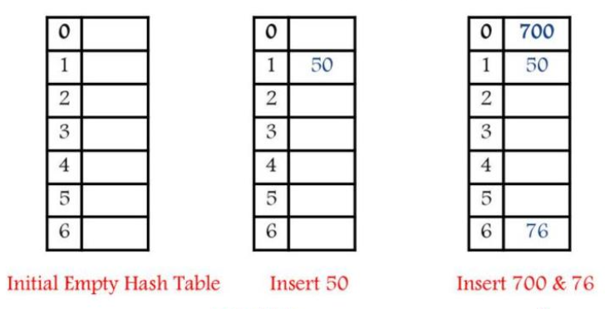
Collision Resolution Techniques => Linear Probing[2]
Performing hash operations on: [key mod 7]
50,700,76,85,92

Slide 29
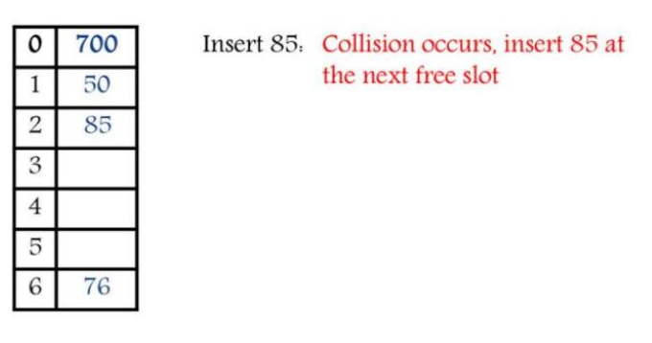
Collision Resolution Techniques => Linear Probing[3]
Performing hash operations on: [key mod 7]
50,700,76,85,92

Slide 30
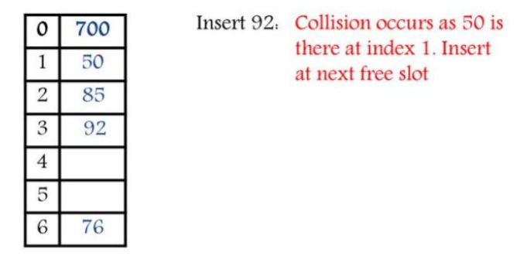
Collision Resolution Techniques => Linear Probing[4]
Performing hash operations on: [key mod 7]
50,700,76,85,92, 73?, 101?

Slide 31
Collision Resolution Techniques => Linear Probing[5]
Advantages
It is easy to compute
Disadvantages
The main disadvantage is clustering
Many consecutive elements might form groups
Might be time consuming to search for empty bucket.
Worst time to search an element is O(s) where s is the table size.

Slide 32
Collision Resolution Techniques => Quadratic Probing
The problem of Clustering can be eliminated if we use the quadratic probing method.
In quadratic probing, when collision occurs, we probe for i²`th bucket in ith iteration. i.e.In quadratic probing, we start from the original hash location i. If a location is occupied, we check the locations :H+1², H+2², H+3², H+4², … H+k² where i= 1 to k
In quadratic probing, f is a quadratic function of i, typically f(i) = i².
For example: Table_Size = 10, hash(x) = x mod 10, f(i) = i², hi(x) = (hash(x) + f(i)) mod Table_Size.

Slide 33
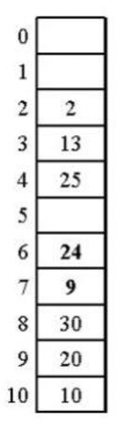
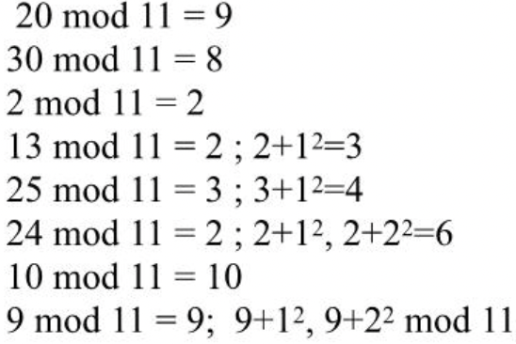

Collision Resolution Techniques => Quadratic Probing[1]
Example: for table size = 11, index from 0…10
Hash Function: h(x) = x mod 11
Inserting keys: 20, 30, 2, 13, 25, 24, 10, 9

Slide 34
Collision Resolution Techniques => Quadratic Probing[2]
Example 2: for table size = 7, index from 0…6
Hash Function: h(x) = x mod 7
Inserting keys: 76, 40, 48, 5, 55
Insert Keys: 76, 93, 40, 35, 47

Slide 35
Collision Resolution Techniques => Quadratic Probing[3]
Advantages
Quadratic probing is less likely to have the problem of primary clustering and is easier to implement than Double Hashing.
Disadvantages
Quadratic probing has secondary clustering. This occurs when 2 keys hash to the same location, they have the same probe sequence. So, it may take many attempts before an insertion is being made.
Also probe sequences do not probe all locations in the table.

Slide 36
Collision Resolution Techniques => Double Hashing
For double hashing, one popular choice is f(i) -= i * hash₂(x).
This formula says that we apply a second hash function to x and probe at a distance hash₂(x), 2hash₂(x), 3hash₂(x), ..., and so on.
The choice of hash₂(x) is essential.
The function must never evaluate to zero.
It is important to make sure all cells can be probed.
A function such as hash₂(x) = R — (x mod R), with R a prime, smaller than Table Size.
Table Size need to be prime.
The cost of double hashing is determined by the use of a second hash function.

Slide 37
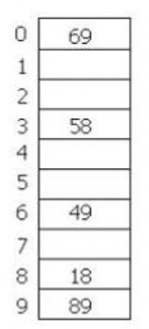
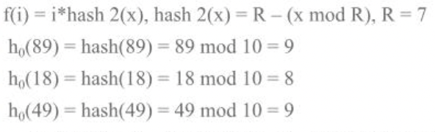
Collision Resolution Techniques => Double Hashing[2]
Ex: Table size = 10, hash(x) = x mod 10
Insert keys: 89, 18, 49, 58, 69

Slide 38
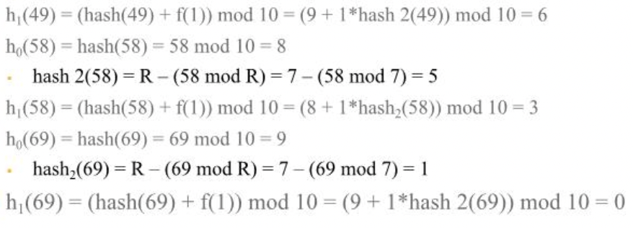
Collision Resolution Techniques => Double Hashing[3]
Ex: Table size = 10, hash(x) = x mod 10
Insert keys: 89, 18, 49, 58, 69

Slide 39
Collision Resolution Techniques => Double Hashing[4]
Ex: Table size = 7, hash(x) = x mod 7
Insert keys: 76, 93, 40, 47, 10, 55

Slide 40
Collision Resolution Techniques => Double Hashing[5]
Advantages
It drastically reduces clustering
Requires fewer comparisons
Smaller hash tables can be used.
Disadvantages
Performance starts degrading as the table fills up.

Slide 41
Rehashing
Rehashing is a technique in which the table is resized, i.e., the size of table is doubled by creating a new table.
While increasing the size, it is preferable that the total size of table is a prime number.
Some situations in which the rehashing is required:
When table is completely full
With quadratic probing when the table is filled half.
When insertions fail due to overflow
In such situations, we have to transfer entries from old table to the new table by re computing their positions using hash functions.

Slide 42
Rehashing[2]
In such situations, we have to transfer entries from old table to the new table by re computing their positions using hash functions.
Example: Compute the hash for keys (37,90,55,22,17,49) with table size 10.
Here, H(key) = key mod tablesize
37 % 10 = 7
90% 10=0
55 % 10 = 5
22% 10 = 2
17 % 10 = 7 Collision solved by linear probing
49% 10 = 9
Now this table is almost full and if we try to insert more elements collisions will occur and eventually further insertions will fail. Hence we will rehash by doubling the table size. The old table size is 10 then we should double this size for new table, that becomes 20. But 20 is not a prime number, we will prefer to make the table size as 23.

Slide 43
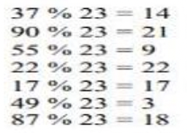
Rehashing[3]
Now the new hash function will be:
h(key) = key mod 23
As seen, now the hash table is sufficiently large to accommodate new insertions.
Advantages
This technique provides the programmer with a flexibility to enlarge the table size if required.
Only the space gets doubled with simple hash function which will avoid the occurrence of collisions.

Slide 44
Applications of Hashing
In compilers to keep track of declared variables.
For online spelling checking, the hashing functions are used.
Hashing helps in Game playing programs to store the moves made.
For browser program while caching the web pages, hashing is used.
Construct a message authentication code (MAC) Digital signature.
Time stamping
Key updating: key is hashed at specific intervals resulting in new key.

